Slide 1
Unit 1: Introduction to ASP.NET MVC

Slide 2
Lesson: ASP.NET MVC
MVC Overview
ASP.NET MVC Overview
Features of the ASP.NET MVC Framework
Understanding ASP.NET Routing
How to create new ASP.NET MVC
Q&A
Reference

Slide 3
MVC Overview
The Model-View-Controller (MVC) architectural pattern separates an application into three main components: the model, the view, and the controller.

Slide 4
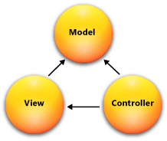
MVC Overview
Models. Model objects are the parts of the application that implement the logic for the application s data domain.
Views. Views are the components that display the application s user interface (UI).
Controllers. Controllers are the components that handle user interaction, work with the model, and ultimately select a view to render that displays UI

Slide 5
ASP.NET MVC Overview
The ASP.NET MVC framework provides an alternative to the ASP.NET Web Forms pattern for creating MVC-based Web applications.
The ASP.NET MVC framework is a lightweight, highly testable presentation framework that (as with Web Forms-based applications) is integrated with existing ASP.NET features, such as master pages and membership-based authentication.

Slide 6
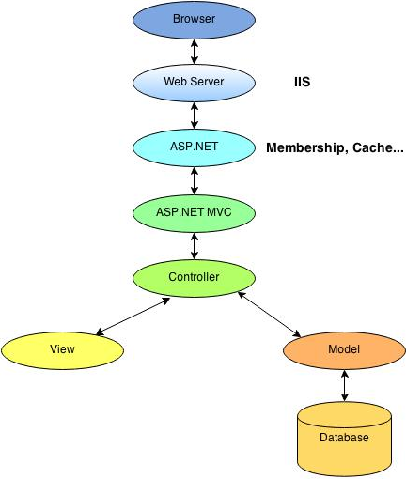
ASP.NET MVC Overview Working Model

Slide 7
Features of the ASP.NET MVC
Separation of application tasks (input logic, business logic, and UI logic), testability, and test-driven development (TDD).
An extensible and pluggable framework.
Extensive support for ASP.NET routing, which is a powerful URL-mapping component that lets you build applications that have comprehensible and searchable URLs.
Support for using the markup in existing ASP.NET page (.aspx files), user control (.ascx files), and master page (.master files) markup files as view templates.
Support for existing ASP.NET features.
Notes:
The ASP.NET MVC framework provides the following features:
Separation of application tasks (input logic, business logic, and UI logic), testability, and test-driven development (TDD). All core contracts in the MVC framework are interface-based and can be tested by using mock objects, which are simulated objects that imitate the behavior of actual objects in the application. You can unit-test the application without having to run the controllers in an ASP.NET process, which makes unit testing fast and flexible. You can use any unit-testing framework that is compatible with the .NET Framework.
An extensible and pluggable framework. The components of the ASP.NET MVC framework are designed so that they can be easily replaced or customized. You can plug in your own view engine, URL routing policy, action-method parameter serialization, and other components. The ASP.NET MVC framework also supports the use of Dependency Injection (DI) and Inversion of Control (IOC) container models. DI enables you to inject objects into a class, instead of relying on the class to create the object itself. IOC specifies that if an object requires another object, the first objects should get the second object from an outside source such as a configuration file. This makes testing easier.
Extensive support for ASP.NET routing, which is a powerful URL-mapping component that lets you build applications that have comprehensible and searchable URLs. URLs do not have to include file-name extensions, and are designed to support URL naming patterns that work well for search engine optimization (SEO) and representational state transfer (REST) addressing.
Support for using the markup in existing ASP.NET page (.aspx files), user control (.ascx files), and master page (.master files) markup files as view templates. You can use existing ASP.NET features with the ASP.NET MVC framework, such as nested master pages, in-line expressions (<%= %>), declarative server controls, templates, data-binding, localization, and so on.
Support for existing ASP.NET features. ASP.NET MVC lets you use features such as forms authentication and Windows authentication, URL authorization, membership and roles, output and data caching, session and profile state management, health monitoring, the configuration system, and the provider architecture.

Slide 8
Understanding ASP.NET Routing
A browser request gets mapped to a controller action through a feature of the ASP.NET framework called ASP.NET Routing.
ASP.NET Routing uses a route table to handle incoming requests.
The route table is setup in the Global.asax file.
Notes:
A browser request gets mapped to a controller action through a feature of the ASP.NET framework called ASP.NET Routing. ASP.NET Routing is used by the ASP.NET MVC framework to route incoming requests to controller actions.
ASP.NET Routing uses a route table to handle incoming requests. This route table is created when your web application first starts. The route table is setup in the Global.asax file. The default MVC Global.asax file is contained in Listing 1.

Slide 9
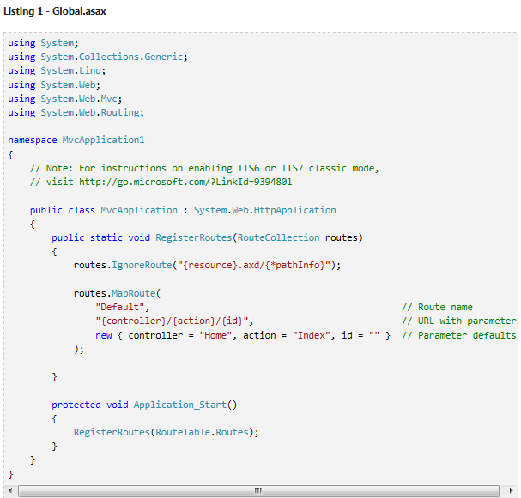
Understanding ASP.NET Routing
When an ASP.NET application first starts, the Application_Start() method is called. In Listing 1, this method calls the RegisterRoutes() method and the RegisterRoutes() method creates the default route table.
Notes:
The default route table consists of one route. This default route breaks all incoming requests into three segments (a URL segment is anything between forward slashes). The first segment is mapped to a controller name, the second segment is mapped to an action name, and the final segment is mapped to a parameter passed to the action named Id.
For example, consider the following URL:
/Product/Details/3
This URL is parsed into three parameters like this:
Controller = Product
Action = Details
Id = 3
The Default route defined in the Global.asax file includes default values for all three parameters. The default Controller is Home, the default Action is Index, and the default Id is an empty string. With these defaults in mind, consider how the following URL is parsed:
/Employee
This URL is parsed into three parameters like this:
Controller = Employee
Action = Index
Id = ��
Finally, if you open an ASP.NET MVC Application without supplying any URL (for example, http://localhost) then the URL is parsed like this:
Controller = Home
Action = Index
Id = ��
The request is routed to the Index() action on the HomeController class.

Slide 10
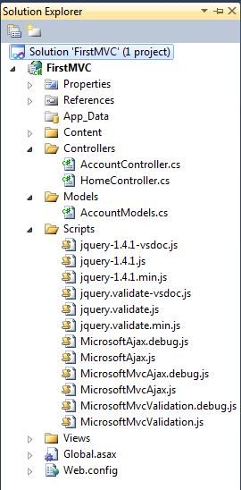
How to create new ASP.NET MVC Create new project
Step 1 : Open VS 2010
Step 2 : Select Visual C# on the left, then pick "ASP.NET MVC 2 Web Application." Name your project “First MVC" and click OK.
If you want Unit Test Project check on Yes, if don’t need check on No
Step 3 : On the right-hand side is the Solution Explorer showing all the files and folders in your application.

Slide 11
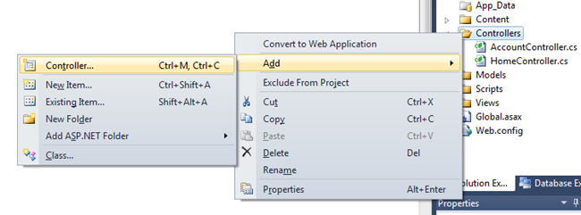
How to create new ASP.NET MVC Adding a Controller - 1
create a new controller by right-clicking the controllers folder in the solution Explorer and selecting Add Controller.
Name your new controller "HelloWorldController" and click Add.

Slide 12
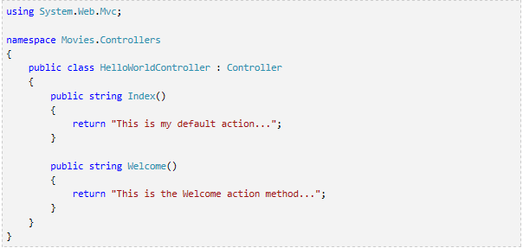
How to create new ASP.NET MVC Adding a Controller - 2
Create two new methods that look like this inside of your new public class HelloWorldController. We'll return a string of HTML directly from our controller as an example.

Slide 13
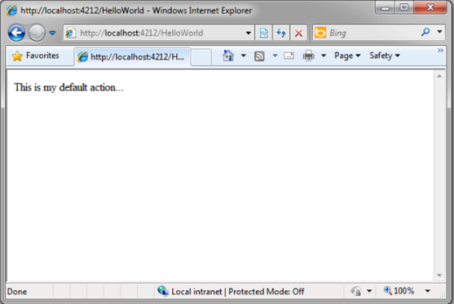
How to create new ASP.NET MVC Adding a Controller - 3
Let's visit http://localhost:xx/HelloWorld

Slide 14
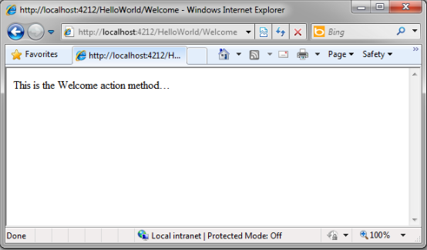
How to create new ASP.NET MVC Adding a Controller - 4
Let's visit http://localhost:xx/HelloWorld/Welcome.

Slide 15

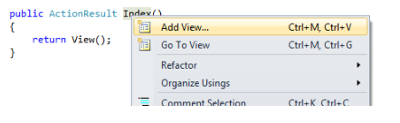
How to create new ASP.NET MVC Adding a View - 1
Let's now change the Index method to instead look like this:
Let's now add a View template to our project that we can use for our Index() method.
This will bring up the "Add View" dialog, don’t change anything, and just click the Add button.
Notes:
Let's now add a View template to our project that we can use for our Index() method. To do this, right-click with your mouse somewhere in the middle of the Index method and click Add View...
This will bring up the "Add View" dialog which provides us some options for how we want to create a view template that can be used by our Index method. For now, don't change anything, and just click the Add button.

Slide 16
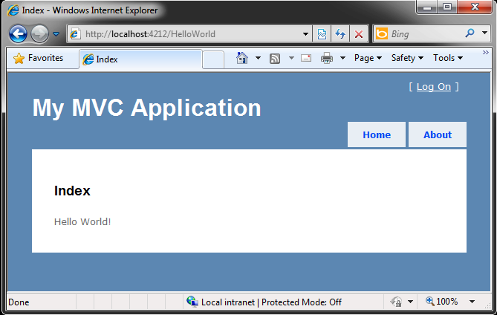
How to create new ASP.NET MVC Adding a View - 2
Let's visit http://localhost:xx/HelloWorld

Slide 17
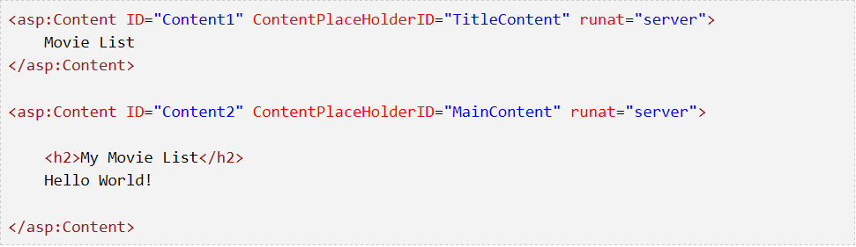
How to create new ASP.NET MVC Adding a View - 3
Changing Views and Master Pages
Go to the /Views/Shared folder in the Solution Explorer and open the Site.Master file.
This file is called a Master Page and it's the shared "shell" that all our other pages use.
let's change the title of the Index page.

Slide 18
How to create new ASP.NET MVC Adding a View - 3
Changing Views and Master Pages
Go to the /Views/Shared folder in the Solution Explorer and open the Site.Master file.
This file is called a Master Page and it's the shared "shell" that all our other pages use.
That placeholder is where all the pages you create will show up, "wrapped" in the master page.

Slide 19
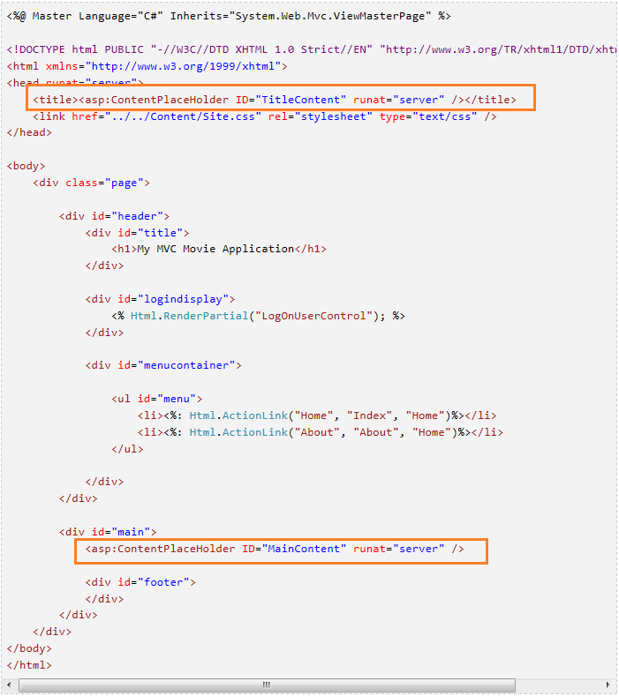
How to create new ASP.NET MVC Adding a View - 3

Slide 20
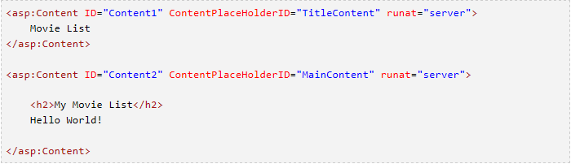
How to create new ASP.NET MVC Adding a View - 4
Changing Title of the Index page
Open /HelloWorld/Index.aspx.
There's two places to change.
First, the Title that appears in the title of the browser,
The secondary header - that's H2 - as well.

Slide 21
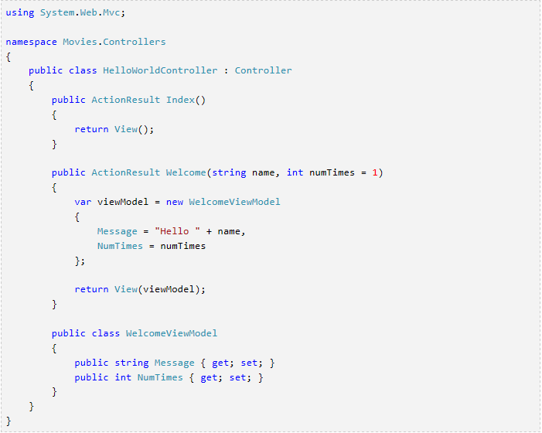
How to create new ASP.NET MVC Parsing a ViewModel
Change the Welcome method inside your controller.
Notes:
Return to the HelloWorldController.cs file and add a new "WelcomeViewModel" class and change the Welcome method inside your controller. Here is the complete HelloWorldController.cs with the new class in the same file.

Slide 22
How to create new ASP.NET MVC Parsing a ViewModel
Change the Welcome method inside your controller.
Notes:
Return to the HelloWorldController.cs file and add a new "WelcomeViewModel" class and change the Welcome method inside your controller. Here is the complete HelloWorldController.cs with the new class in the same file.

Slide 23
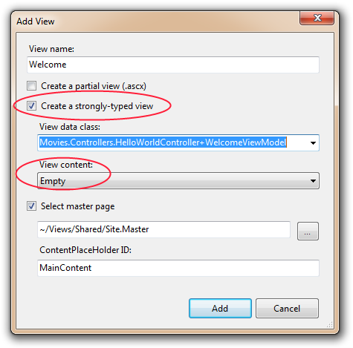
How to create new ASP.NET MVC Parsing a ViewModel
Now we need a Welcome View template
Notes:
Right click in the Welcome method and select Add View. This time, we'll check "Create a strongly-typed view" and select our WelcomeViewModel class from the drop down list. This new view will only know about WelcomeViewModels and no other types of objects.
NOTE: You'll need to have compiled once after adding your WelcomeViewModel for to show up in the drop down list.

Slide 24

How to create new ASP.NET MVC Parsing a ViewModel
Add this code under the <h2> in your new Welcome.aspx.
Notes:
Also, notice while you're typing that because we told this View about the WelcomeViewModel (they are married, remember?) that we get helpful Intellisense each time we reference our Model object.

Slide 25
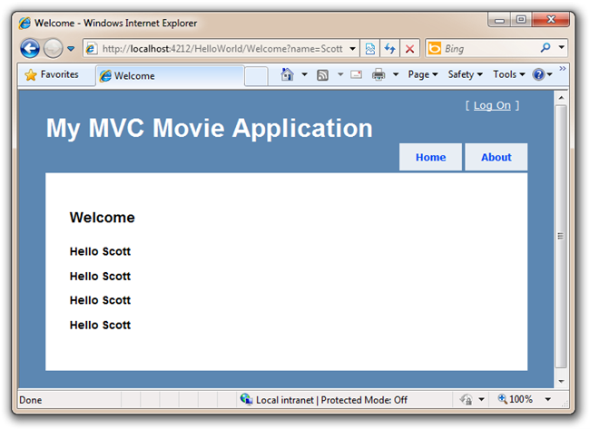
How to create new ASP.NET MVC Parsing a ViewModel
Notes:
Also, notice while you're typing that because we told this View about the WelcomeViewModel (they are married, remember?) that we get helpful Intellisense each time we reference our Model object.

Slide 26

Demo
Notes:
Refer to this link to demo
http://www.asp.net/mvc/tutorials/older-versions/getting-started-with-mvc/getting-started-with-mvc-part1

Slide 27

Q&A

